Slide 1
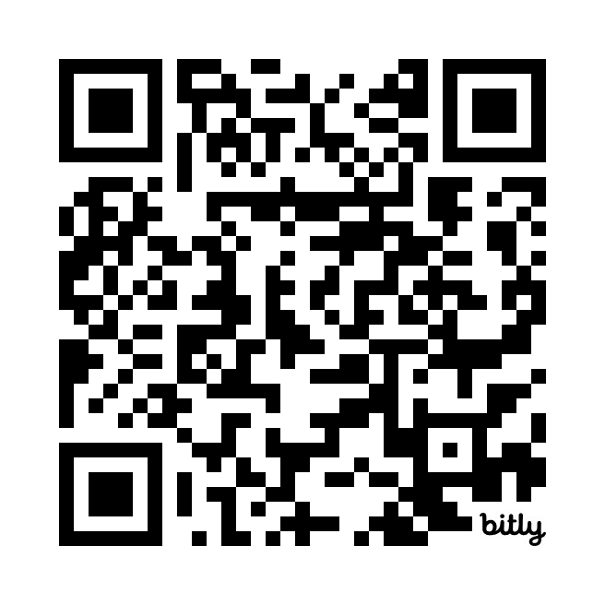
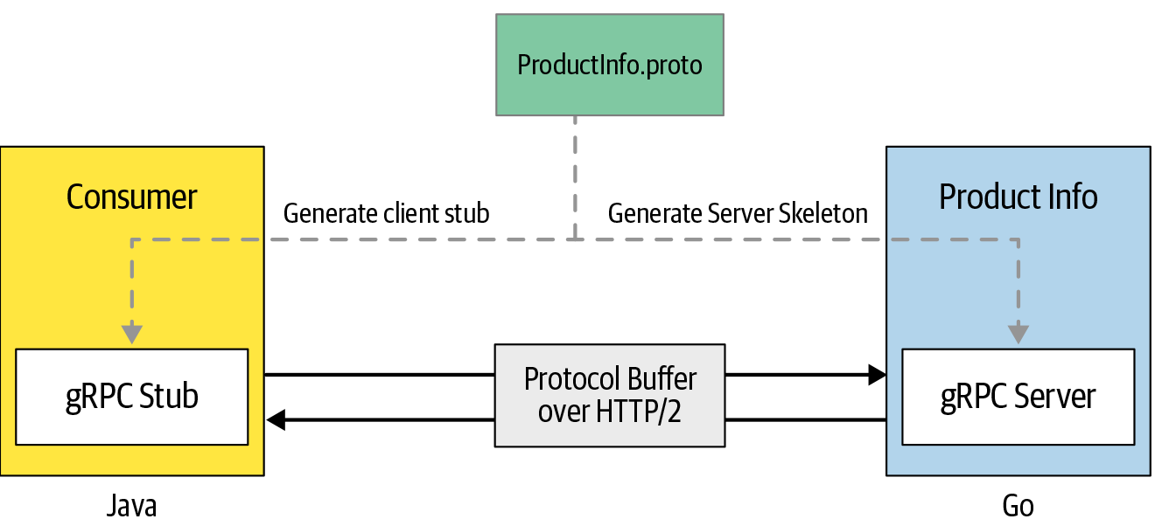
gRPC APIs Quiz
https://bit.ly/3xnXyga

